Slide 1
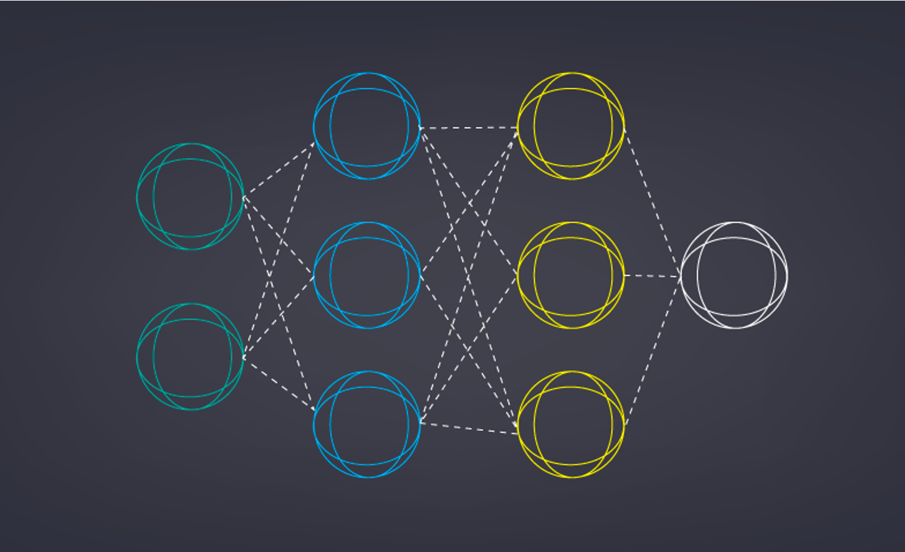
Image Colorization with Deep Convolutional Neural Networks
Mit20
Tahseen zaman
Student No: 132032
Supervised by:
Dr. Ahmedul Kabir
Assistant Professor

Slide 2
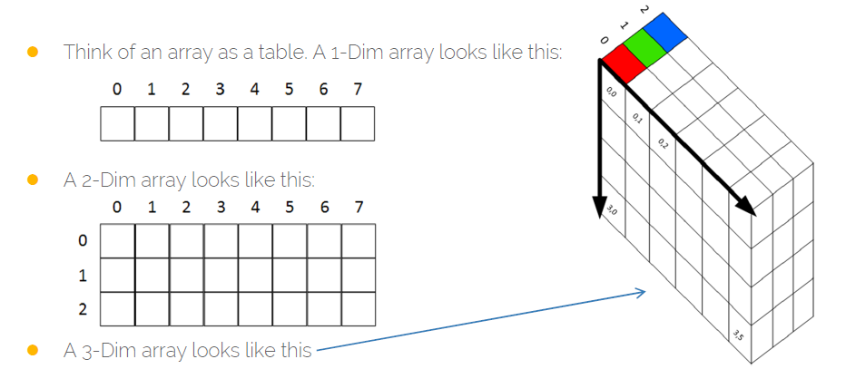

Objective:
Taking a Black and white image as input produced a colorized image that represents the semantic colors and tones of the input using the Convolutional Neural Network model.
Image and Colorization:
Images are represented with different color spaces in Digital formats like RGB,HSV,CMYK. Color Images are of 3D Arrays. LAB expresses color as three values: L for black and white, a for green (−) to red (+), and b for blue (−) to yellow (+).

Slide 3
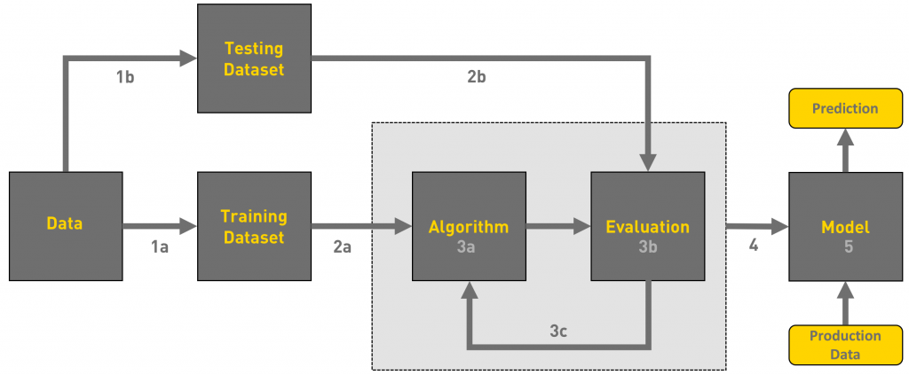
Machine learning workflow:
Gathering data(colored-B&W images)
Data pre-processing(Converting Images to LAB color space,224x224x3PIXEL)
Researching the model that will be best for the type of data(Encoder-Decoder by CNN)
Training and testing the model
Evaluation(Cross Validation)

Slide 4
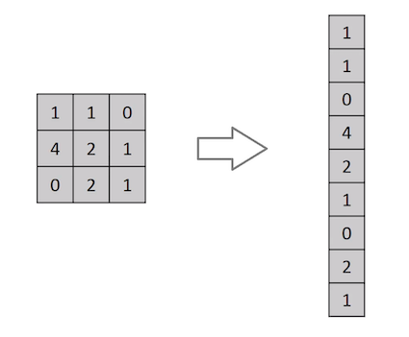
Why cnn, not Forward feed is preferred?
Gives better accuracy compared to forward feed networks
No need to preprocess the data for features
Model has better understanding of spatial features of Images
System learns Features by itself from examples then Features of one layer is passed to another layer

Slide 5
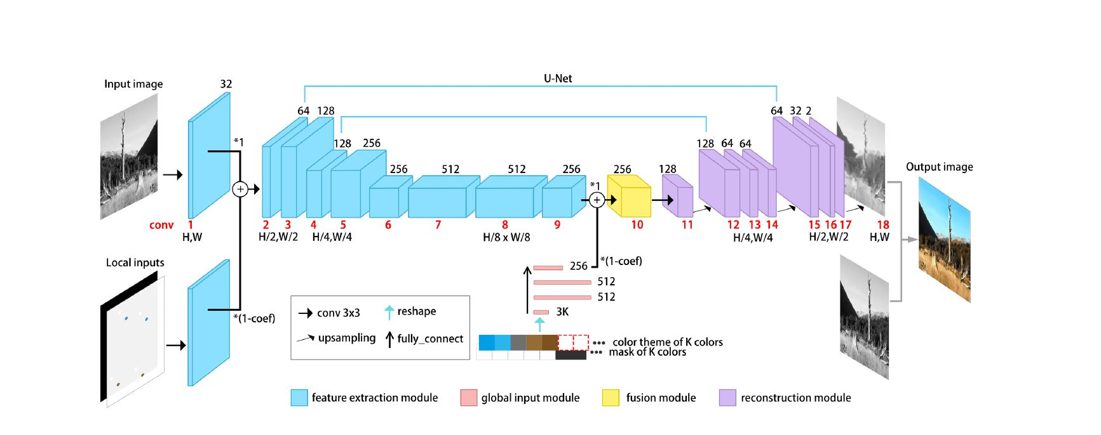
Methodology:
Using a Encoder-Decoder, based on deep convolutional Neural Network.
the input image the dimension are reduced-Encoding
then the dimension are brought back to original-Decoding
Weights and biases are calculated
Can do the process for future input

Slide 6
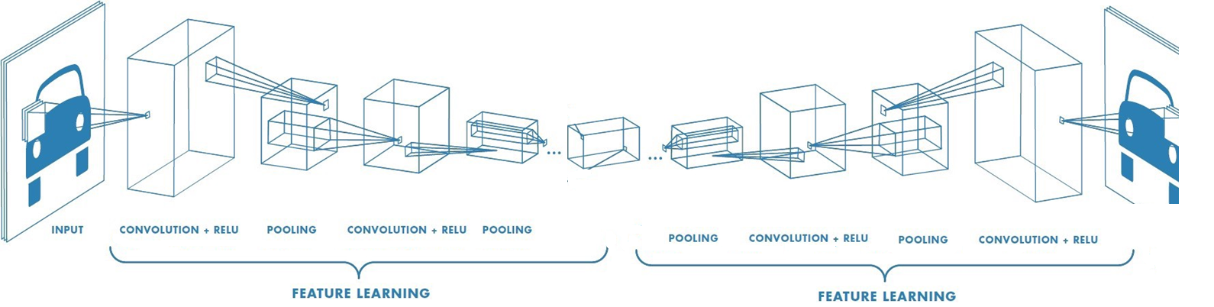
LAYERS OF Encoder & Decoder:
One Convolution layer and one Pooling is referred as depth one for convolution
Our model depth is of 7 for Encoding 7 for Decoding
ENCODER AND DECODER

Slide 7
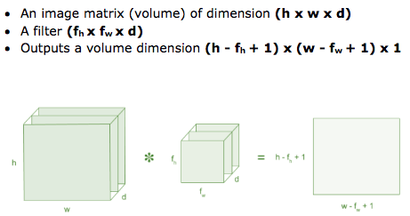


Convolution Layer –The kernel Filtering:
Feature extraction from image data is done by Kernel matrix convolution
Our kernel size is (3x3)
Works on 3 copies of L, Generates L, A , B

Slide 8
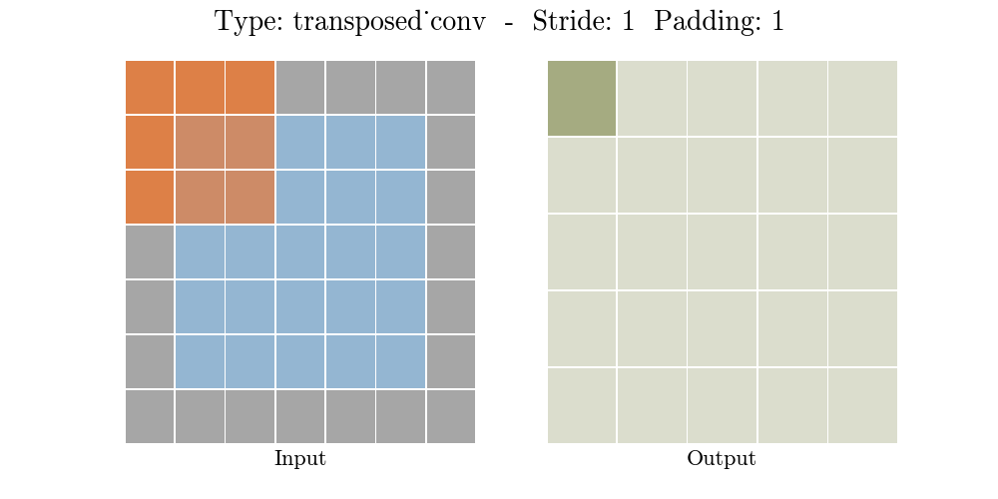
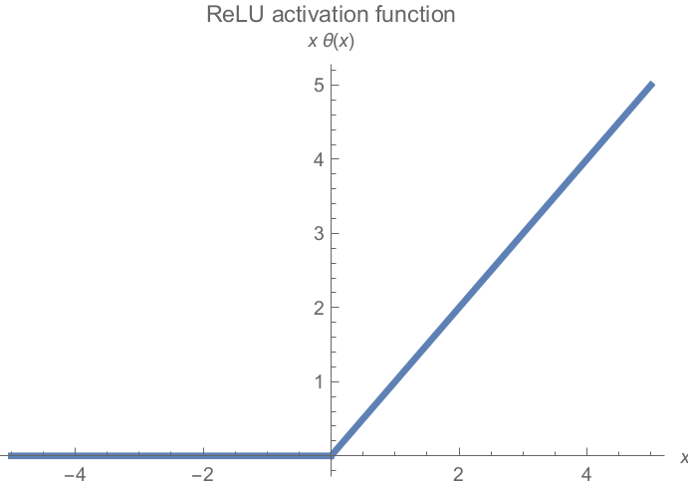
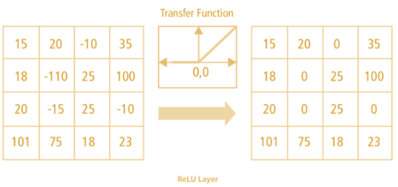
Padding & Non linearity(relu):
Padding: The frame size of zeros inserted around the input feature map
We are Using padding of 1,protect data at edge
Activation function, Relu introduces non-linearity into the output

Slide 9
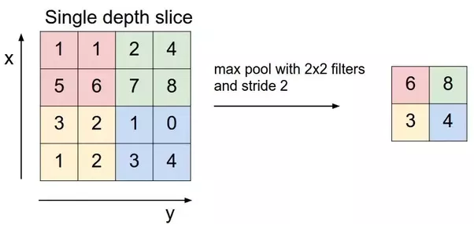


Pooling Layer:
Reduce the amount of parameters and computation in the network
The Matrix is downsized keeping relevant features data intact- pooling
Can be done using average pooling, max pooling
we are using max pooling with window 2x2 and stride 2

Slide 10

Decoder:
Increase the size of the output feature map
This requires Transpose convolution and up sampling
The idea behind the transposed convolutional layer is to undo (not exactly) the convolutional layer

Slide 11
Loss calculation:
We are measuring mean Square Error, the estimated value and labels are real numbers
back propagation:
Back propagation is not a structural element of the CNN, rather its the methodology through which we learn the underlying problem by updating the weights in the opposite direction of the change in gradient.
We will train the model for 100 epochs.

Slide 12
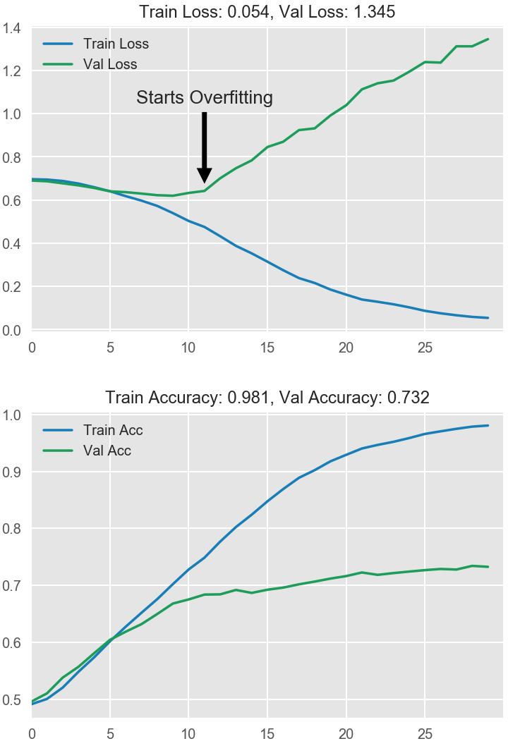
Testing the model:
We will Train the model for 25,000 images
Then we will test the model for noble data, images that was not shown to model in testing phase
Testing will be done for 20% of training test, 500 images
We expect the accuracy of Testing will be very close to accuracy of validation set.
Our desired accuracy is 92%,which is high in CNN.

Slide 13
Progress of this project:
The theoretical background :
Regression, Classification, K-nearest neighbor
Back propagation
Convolutional neural network
Languages : keras
Problem solved:
A de-noising Encoder-Decoder with MINST data set.

Slide 14
References used:
Most of the Figures Used:
https://towardsdatascience.com/applied-deep-learning-part-3-autoencoders-1c083af4d798
https://towardsdatascience.com/applied-deep-learning-part-4-convolutional-neural-networks-584bc134c1e2
Theory and Methodology:
A Comprehensive Guide to Convolutional Neural Networks —_ by Sumit Saha
Understanding of Convolutional Neural Network (CNN) — Deep Learning _ by Prabhu _ Medium

